Slide 1
BlinkIt Sales Analysis

Slide 2
Objective
To conduct a comprehensive analysis of Blinkit’s sales performance, customer satisfaction and inventory distribution to identify key insights and opportunities for optimization using various KPI’s and visualizations in Power BI.

Slide 3
Tools Used: Power BI Techniques Used: Power Query Editor DAX Expressions (SUM, COUNTROWS, AVERAGE) Graphs Ans Charts Filters and Slicers KPI Cards

Slide 4
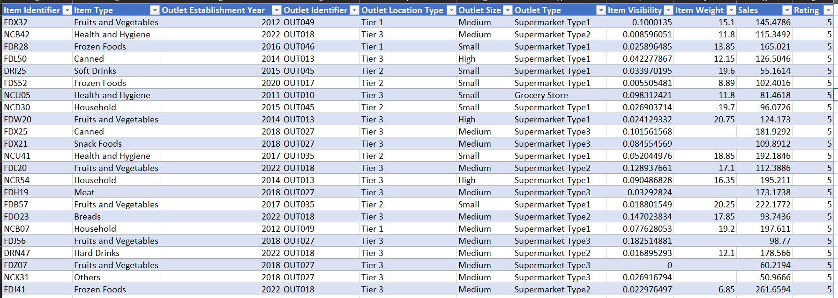
Dataset Description
The given data is of the blinkit company a renowned company that delivers food items , household items to the customers. The dataset is taken from Kaggle.com and it consists 8523 rows & 12 columns.

Slide 5
Item Identifier: Unique Item code Item Type: Category of items (Fruits and Vegetables, Frozen Food, …) Outlet Establishment Year: The outlet was opened in which year. Outlet Identifier: Unique Outlet code Outlet Location Type: The outlet is located in a Tier 1, Tier 2, or Tier 3 city. Outlet Size: Whether the outlet is small, large or medium in size. Outlet Type: Whether the outlet is Supermarket Type1, Type2, Type3 or Grocery Store. Item Visibility: What is the percentage of the item searched or shown on the page? Item Weight: Weight of the item Sales: Amount of the quantity sold Rating: The rating given by customers to products (between 1 and 5).

Slide 6
Data Cleaning
Replaced “reg” values with “regular” and replaced “low fat” with “Low Fat”.
There were some missing values in “Item Weight” column. So removed those missing rows.

Slide 7
KPI Requirements
Total Sales: The overall revenue generated from all items sold
Average Sales: The Average revenue per sales
Number of items: The total count of different items sold
Average rating: The average customer rating for items sold

Slide 8
Recommended Data Analysis
What are the Total Sales, Average Order, Average Rating of the Company?
Which are top 5 selling Item Type?
Which outlet location generates the highest revenue?
Which outlet size contributes the highest revenue?
Which outlet type contributes the highest revenue?

Slide 9
Data Analysis
What are the Total Sales, Average Order, Average Rating of the Company?
- The total sales of the company is $ 997.16K.
- The Average order of the company is $ 141.
- The Average rating of the company is 3.9.
Which are top 5 selling Item Type?
The top 5 selling item types are as follows:
Fruits and Vegetables
Snack Foods
Household
Frozen Foods
Dairy

Slide 10
Which outlet location generates the highest revenue? - Outlets in Tier 2 generates the highest revenue ($ 393.15K). Which outlet size contributes the highest revenue? - Medium outlet size contributes the highest revenue ($ 377.18K). Which outlet type contributes the highest revenue? - Supermarket Type 1 contributes the highest revenue ($ 787.5K).

Slide 11
Conclusion
We can observe that the highest sales come from Tier 2 cities, indicating a scope for business expansion in these areas. Additionally, attention should be given to Tier 3 cities, as they account for lower revenue.
Average sales are not very good, so they should be given priority.
We can observe that the average sales is almost same for all the outlets.

Slide 12
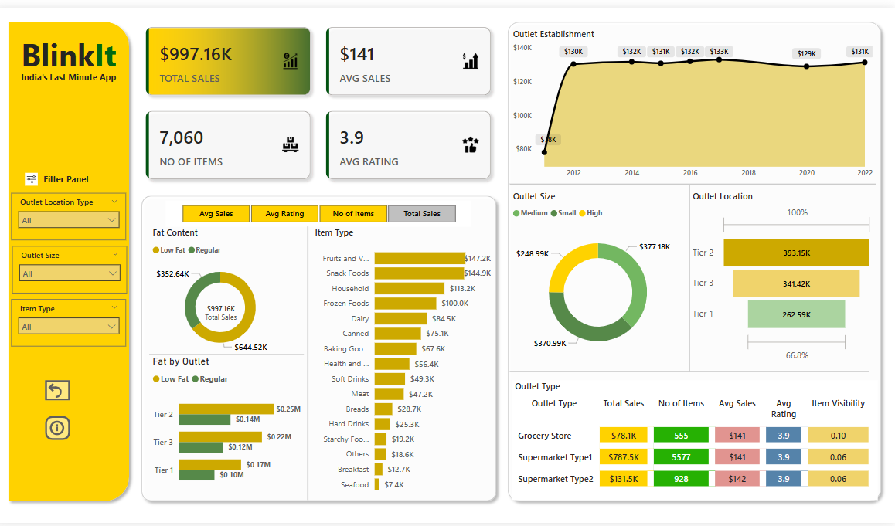
Dashboard Snapshot

Slide 13
Thank You

